Slide 1
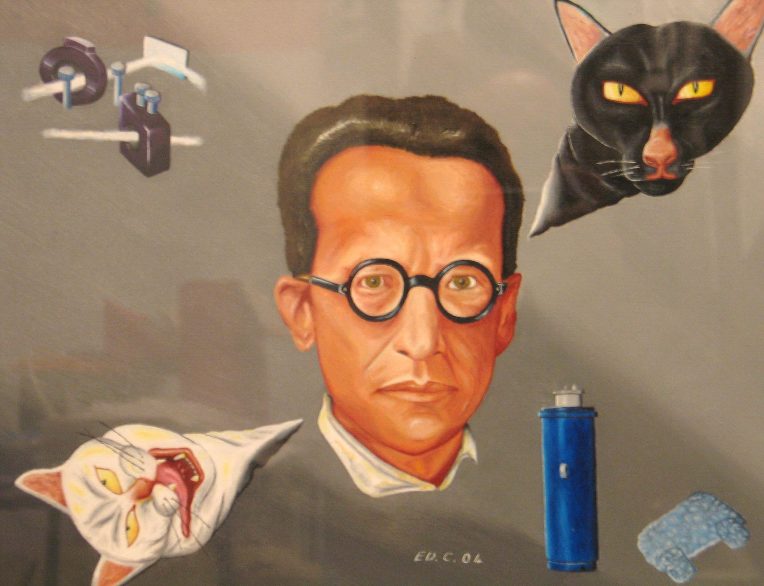



Circuits mésoscopiques quantiques:
La voie des qubits robustes
vers le calcul quantique
Daniel ESTEVE
AEIS, Institut Curie, Oct. 2021

Slide 2
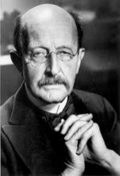
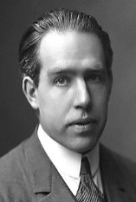
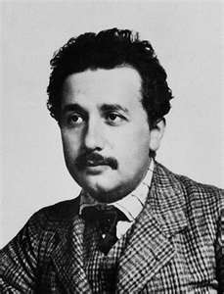
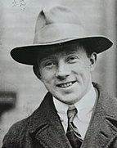
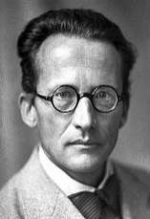
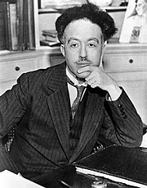
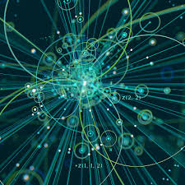
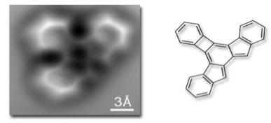
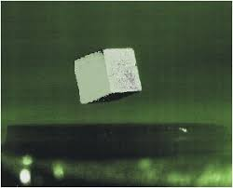
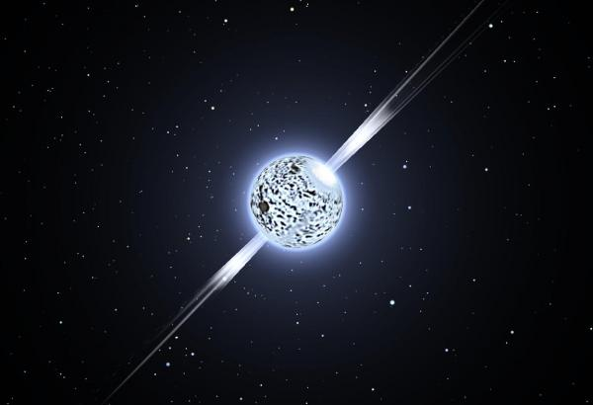
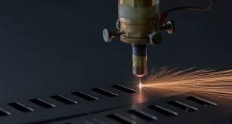
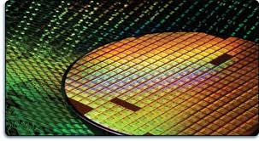
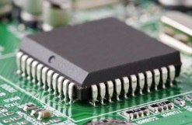
The (first) quantum revolution
1900-1930
a revolutionary formalism:
-Superposition principle:
The superposition of physical states is still a possible physical state
The superposition defines the quantum state and the
possible outcomes of a measurement
-Evolution rules of quantum state among all possible superpositions
1930s Quantum formalism applied to all areas of physics and at all scales
Particles nuclei atoms molecules condensed matter neutron stars …
The basis of many technologies based on advanced materials (lasers, semiconductor electronics,...)
But does QM apply to all
degrees of freedom ?
Second quantum revolution of quantum machines ?

Slide 3

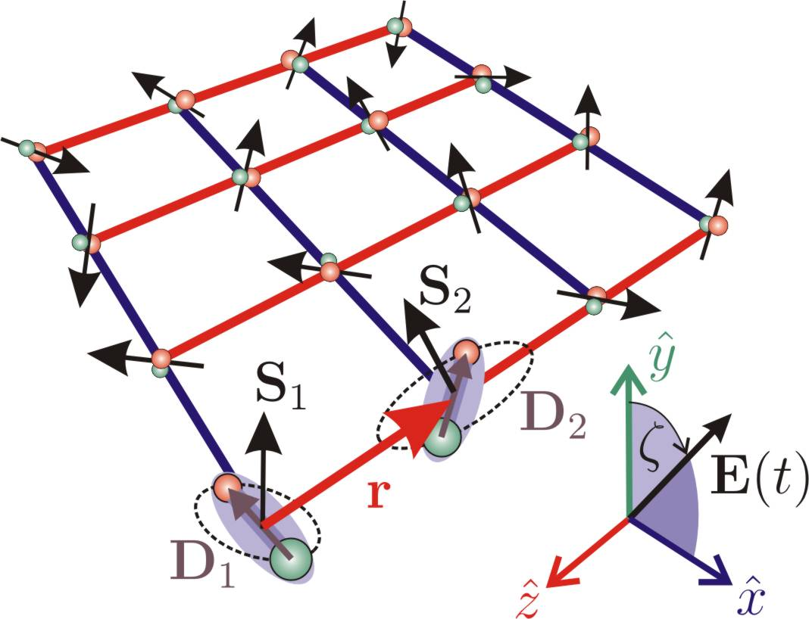
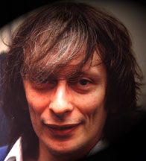
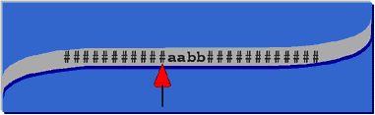
Quantum machines for Quantum Computing
1982: Solving quantum systems too difficult
quantum simulation needed!
1985: unexpected breakthrough
Quantum mechanics provides
computational resources
R. Feynman
D. Deutsch,
and others
Classical computing:
001
0/1
0/1
0/1
0/1
0/1
0/1
0/1
N (0,1) bits evolving
among 2^{N} states
0/1
0/1
0/1
0/1
0/1
0/1
0/1
Universal Turing machine ?
Quantum computing:
Readout
evolution of a N qubit
quantum register among
superpositions of 2^{N} basis states
H
qubit
X
returns 0 or 1
for each qubit :
a basis state
2 level system
Z
H
n
Y
N = 2^{n} computational
basis states
(entangled state)

Slide 4
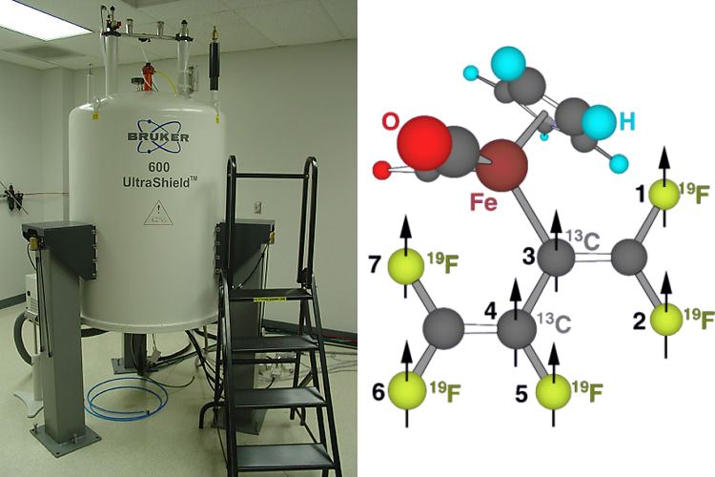
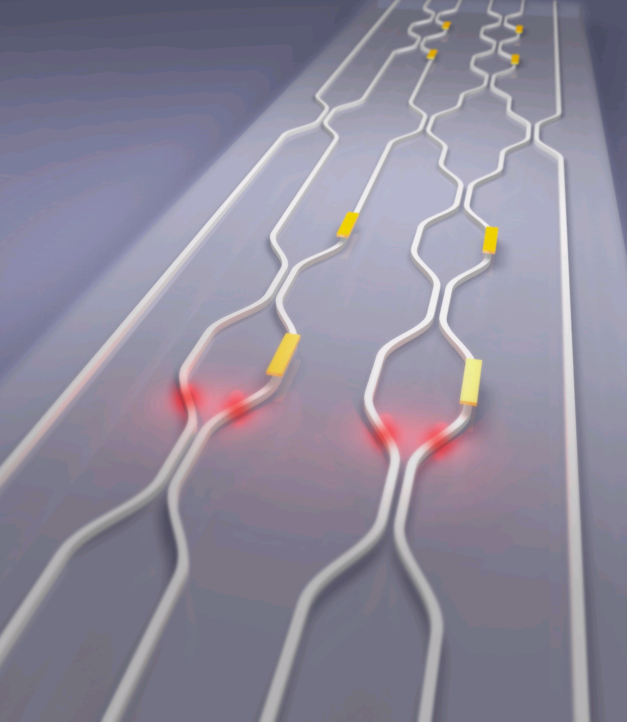
A disruptive technology ? Physical implementations ?
Trapped ions
(or atoms)
NMR
Photons
Photons weakly interact
->measurement based QC
efficiency ?
An advanced platform
not scalable
usually not quantum !
superconducting qubits
semiconduting qubits (less advanced, scalable fab.)
Electrical circuits ?

Slide 5
readout port
A major issue: coupling to the environment
yields decoherence
a
?
1
0
+
1
U₁
b
0
write
Readout
Decoherence
Sources

Slide 6
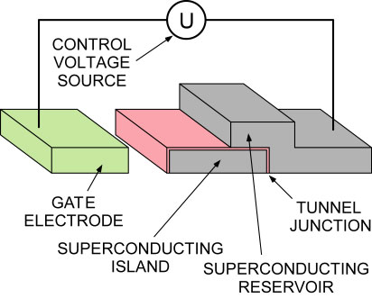
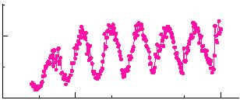
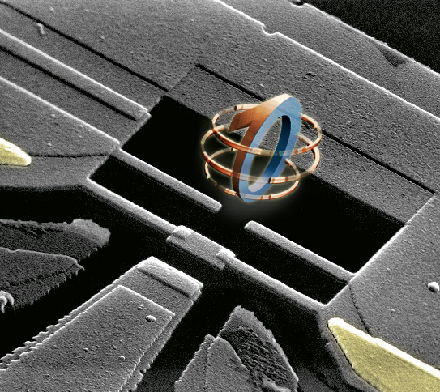

An electrical quantum bit : the Cooper pair box
Quantronics
1997
solvable quantum circuit
200 nm
1 degree of freedom
{ N, θ }
Ng=CgU/2e
quantum coherence btw 2 states
(Nakamura, Pashkin & Tsai, 1999)
in the Cooper pair box circuit
Rabi oscillations
5
0
200
A true artificial atom :
Quantronium circuit
(Vion et al., 2002)
400
600
Pulse durationΔt (ps)
Qu coherence measurement
T₂ = 500 ns
T₁=2μs
control,
single shot readout
&
coherence

Slide 7
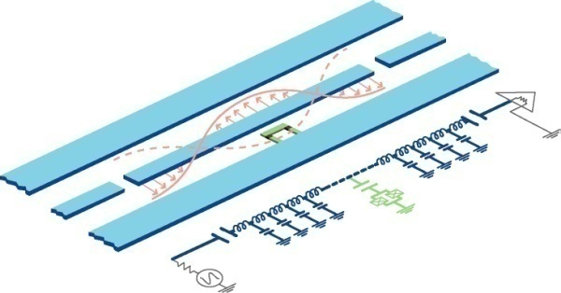
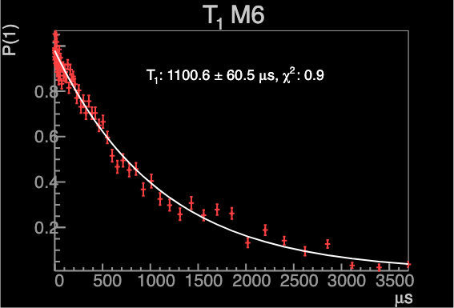
Superconducting qubits : state of the art
Transmon
Cooper pair box in microwave cavity
(Yale, 2007)
cavity freq.
sensitive to qubit state
(readout)
1D CPW
resonator
Coherence time up to 100 μs
~
X100
Cooper pair
box qubit
Recent progress:
anharmonic oscillator
qubit
Reducing
material losses (Ta) improves quantum coherence
(Princeton 2020)
X3
Ta
Al /AlOx/Al
Josephson junction
Coherence time: 250 μs
process tested
IBM, China
Quantronics, …
X4
Best result from IBM
(unpublished)
T_{1,} T₂ in ms range
But processors not yet there….

Slide 8
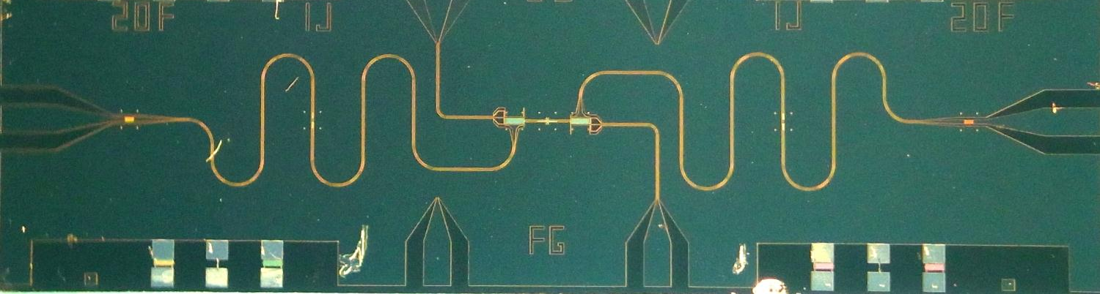
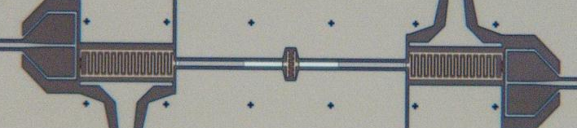


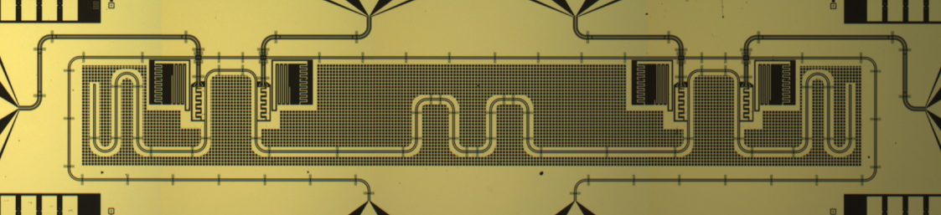
Quantum processors ?
?
?
0
1
1
1
0
1
U₂
0
0
Proof of concept of
an elementary
two qubit processor
U₁
U₁
tunable qubits
1 mm
Quantronics, 2012
Dewes et al., PRL & PRB 2012
200 µm
demonstration of the Grover
search quantum algorithm
(here: find 1 state out of 4
in a single identification call )
Oracle
Readout
|0>
Y_{π/2}
iSWAP
Z_{±π/2}
iSWAP
X_{π/2}
0
1
Proof of principle of
quantum acceleration
|0>
Y_{π/2}
Z_{±π/2}
X_{π/2}
0
1
4 qubit processor with
multiplexed readout
8
8

Slide 9
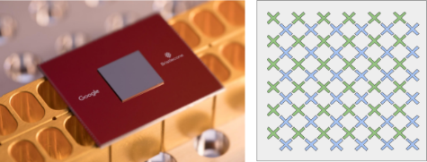








The scalability challenge
Use-cases for gate-based
quantum computing
needs >100 logical qubits
?
Gate-based quantum processor:
quantum coherent qubits, universal set of gates, readout, reset
Quantum systems:
quantum chemistry, materials,
nuclear physics, …
Linear algebra:
quantum inversion of
sparse matrices
Classification :
Optimization
Machine learning
?
0
?
0
1
1
U₂
1
1
0
0
N
Early 2010’s:
proof of principle of small quantum
processors
Quantum Error
correction issue:
copy forbidden
U₁
U₁
2019:
Google Sicamore 53 qubit processor
9
3

Slide 10
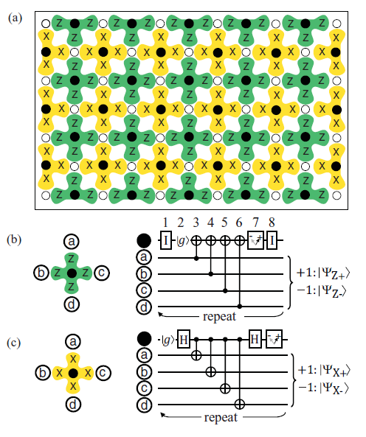

Strategies for addressing the quantum error correction challenge
Fault-tolerant architecture based on the Surface Code
Method: detect & identify error
correct, or keep record
( Fowler et al, PRA 86 , 2012)
pro : <1 % error threshold enough
Data measurement
con : huge resource overhead
1 logical qubit >>10³ physical qubits
ONLY POSSIBLE WITH
SCALABLE FAB
adapted to semiconducting qubit
LSI circuits
5

Slide 11
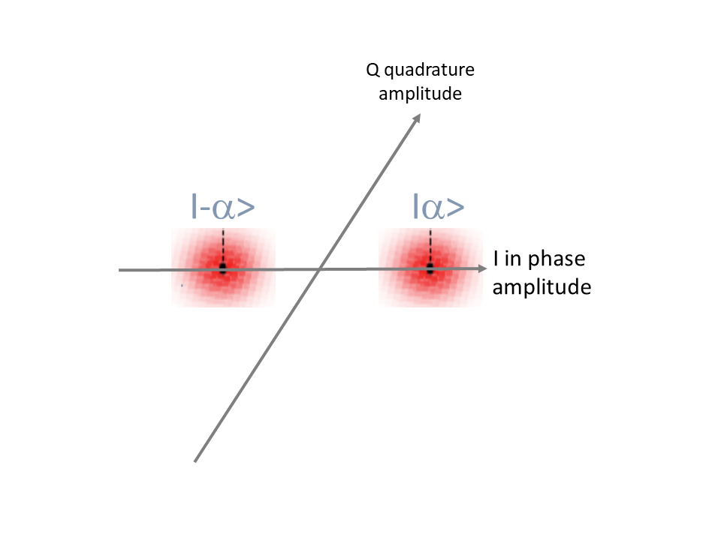
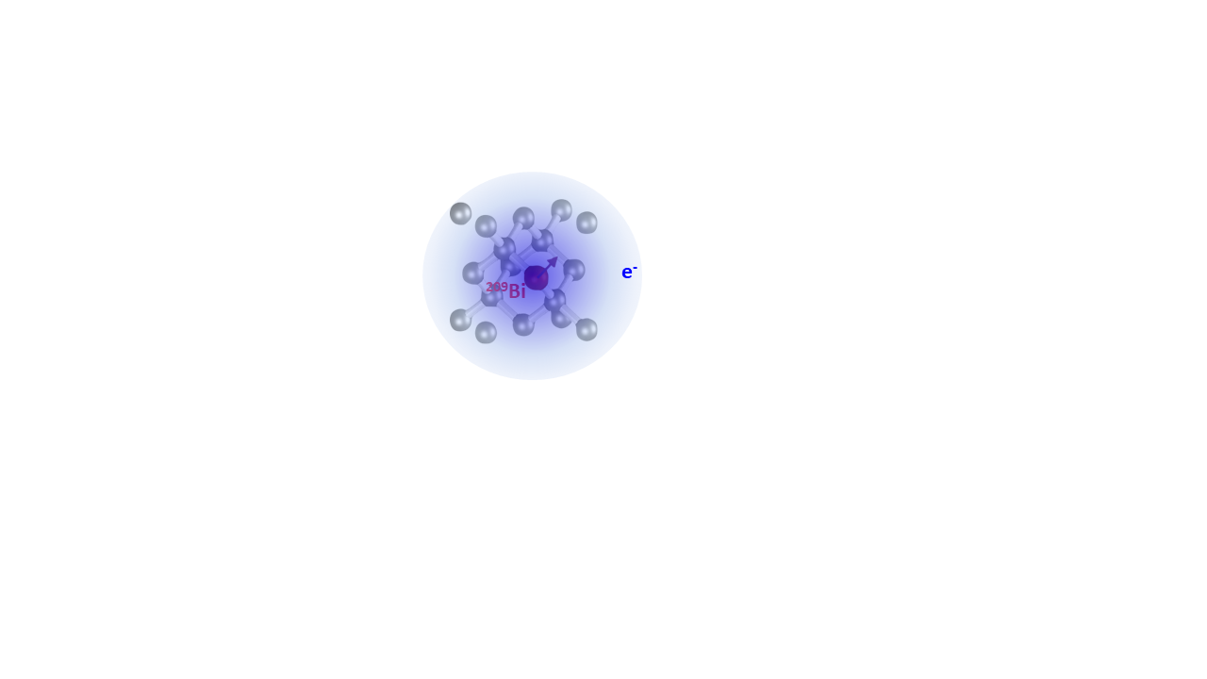
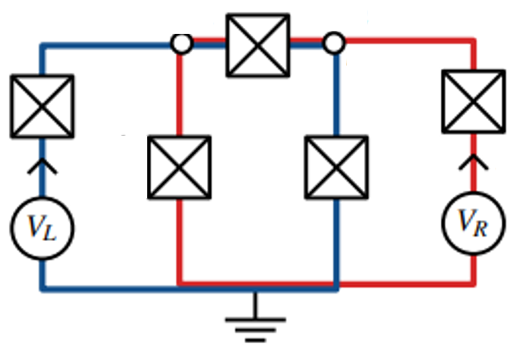
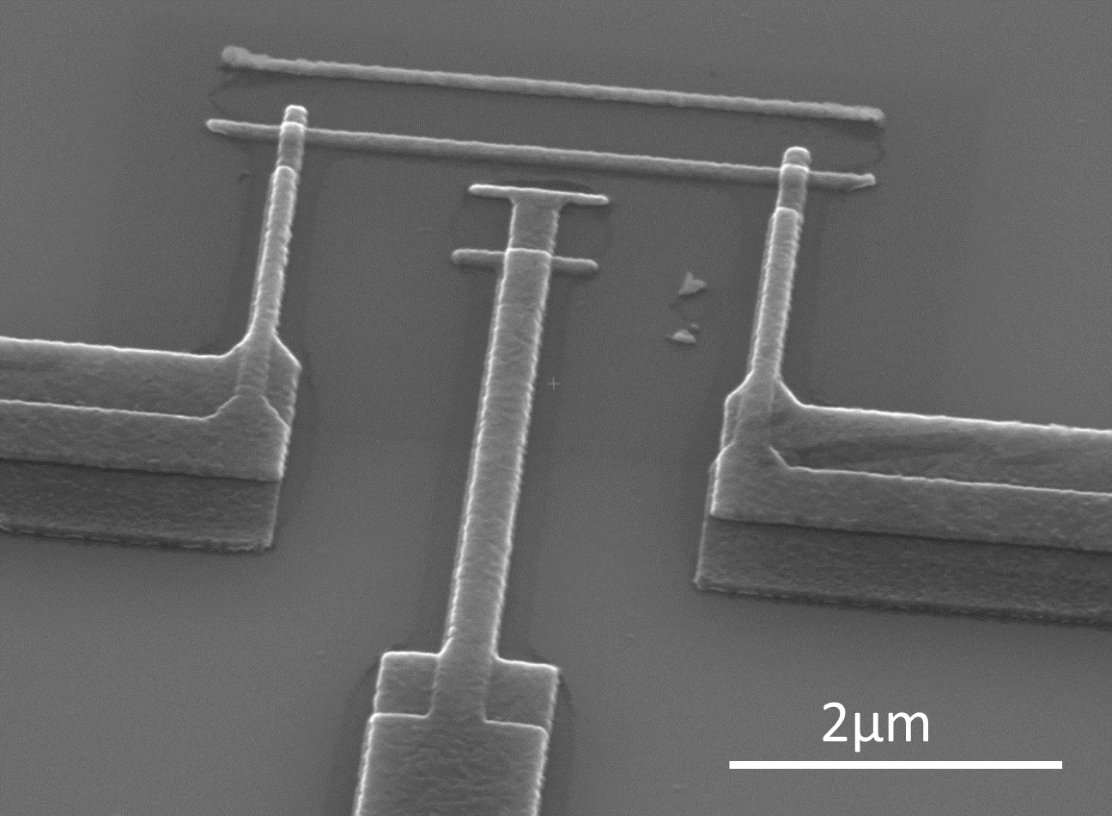

Other routes ? Robust qubits with more coherence and less overhead
Cat-state qubits
impurity spin qubits
topologically protected qubits
Qubit states built from
high Q resonator coherent states
electro-nuclear levels with
superior quantum coherence
qubit
states
Coherent state -
Coherent state +
Full protection: in progress Lescanne et al., Nat Phys 2020
1D code of cat-qubits (est x50 overhead)
fault-tolerant architecture
Guillaud-Mirrahimi PRX 2019
Suppressing decoherence channels by circuit design
Coherence times
up to seconds
but microscopic objects
hard to control
Quantic team (ENS, INRIA, Mines)
Alice&Bob , Yale
(Amazon)
6

Slide 12
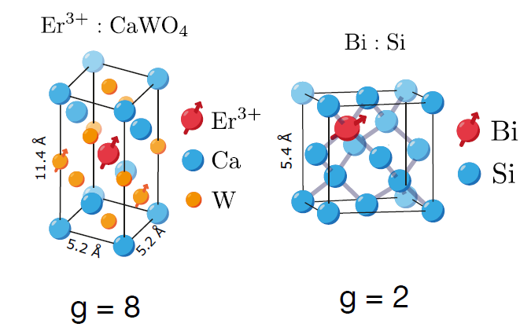
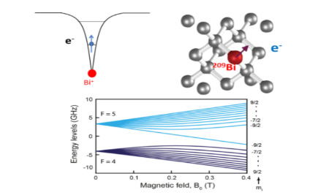
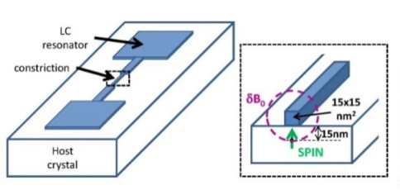
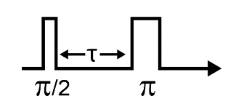
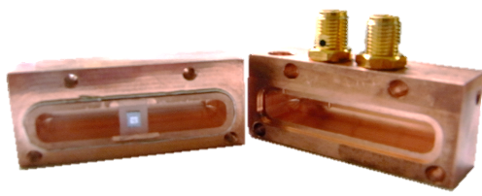
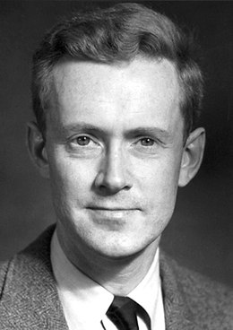




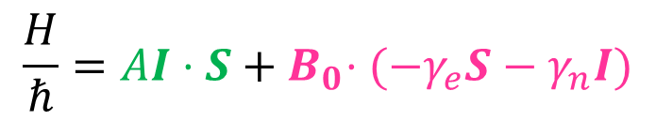
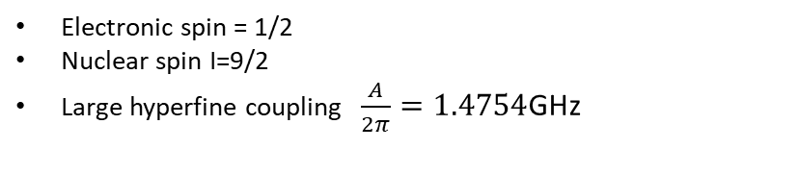

A new hybrid route : spins coupled to superconducting circuits
Highly coherent
electro-nuclear
spin states
controlled
coupling to
environment
with good quantum
coherence
Coherence times:
electronic spins: ms, s
nuclear spins: s, h
Strong coupling:
radiative relaxation
channel dominant
(Purcell regime)
Electronic spin = 1/2
Nuclear spin I=9/2
Large hyperfine coupling $\frac{A}{2π}=1.4754$GHz
$$ω_{0}, Q$$
$$\frac{H}{ℏ}=AI⋅S+{ B}_{0}⋅(−γ_{e}S−γ_{n}I)$$
1946
E. Purcell
$$γ_{P}$$
20 electro-nuclear states
for making qubits

Slide 13
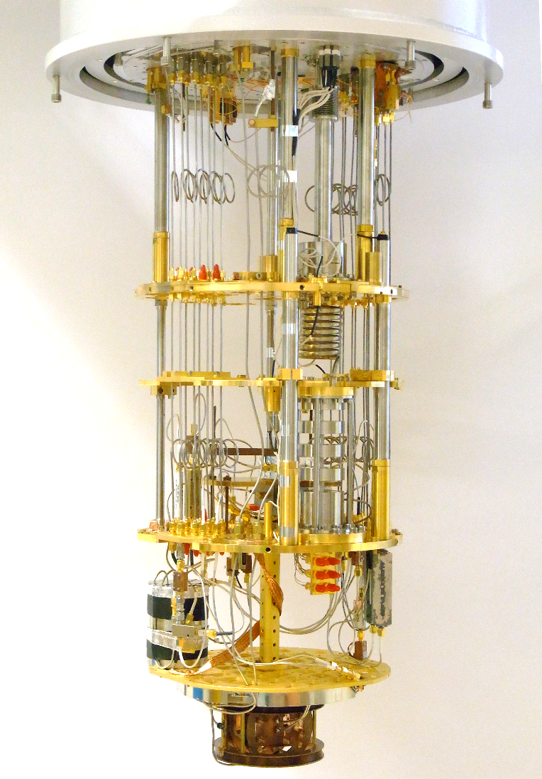


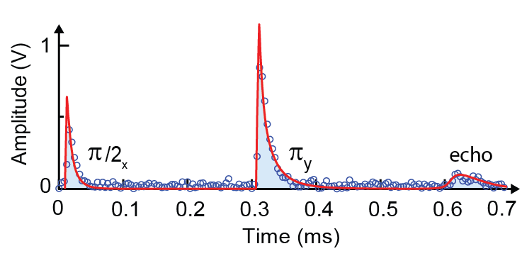


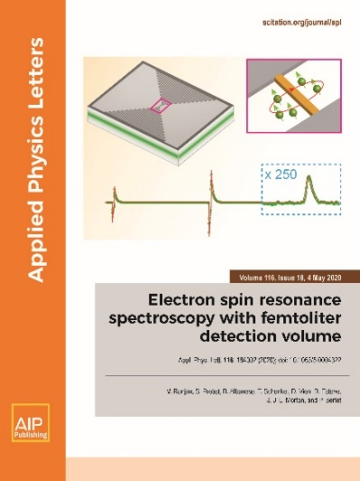
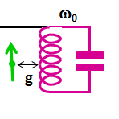

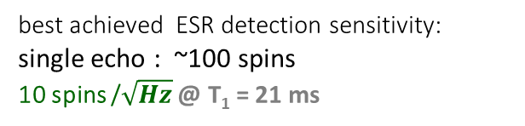
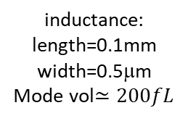

Quantum limited ESR spectrometry
τ
τ
Signal
Input
Signal
Output
2ω₀
ω₀
JPA pump
time
4K
300K
π/2
π
echo
40dB
$$A_{e}=∫dtI(t)$$
20dB
4K
50dB
10mK
+20dB
best achieved ESR detection sensitivity:
single echo : ~100 spins
10 spins /$\sqrt{Hz}$ $\text{@ }\text{T}\text{1}\text{ = 21 }\text{ms}$
S. Probst et al.,
Appl. Phys. Lett. (2017)
Amplifier at
quantum limit
B_{xy}
3D Cavity
10mK
Planar
Resonator
inductance:
length=0.1mm
width=0.5μm
Mode vol$≃200fL$

Slide 14
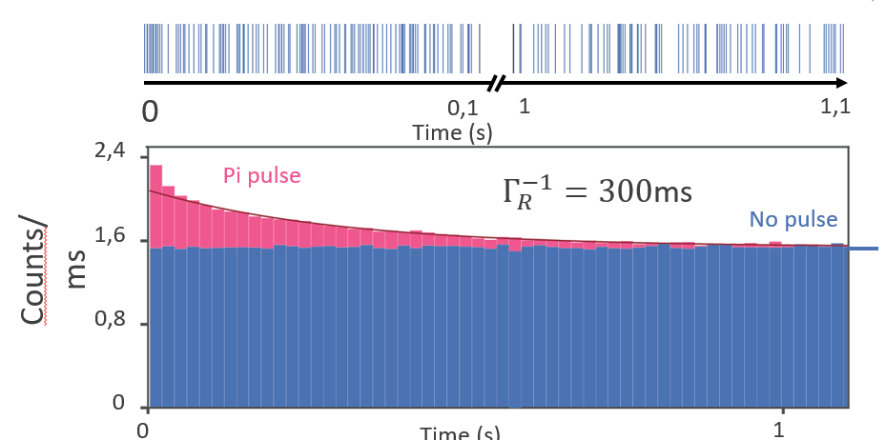
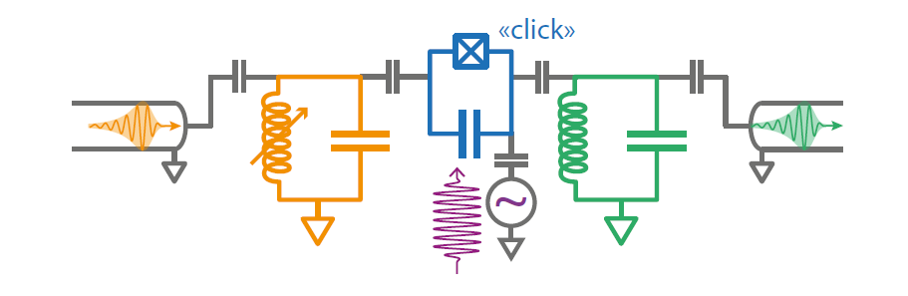
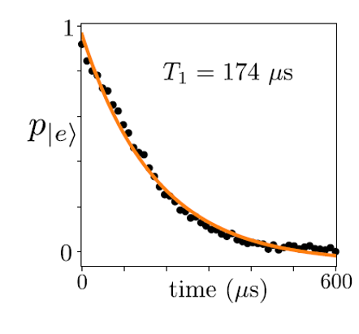

A new detection strategy based on a single microwave photon counter
E. Albertinale…& E. Flurin
to appear in Nature
arXiv:2102.01415
spin fluorescence
Bienfait et al.,
Nature 2016
Lescanne, …. & Flurin,
PRX10, 2020
photon
Single Microwave
Photon Detector
Click !
signal
mixing with photon excites a transmon
qubit readout :
click !
Circuit:
‘state of the art’
transmon qubit
Time (s)
Rabi oscillations
detected
by fluorescence:
dark count rate:
70 counts/s
goal:
1 count/s

Slide 15
A new detection strategy based on a single microwave photon counter
E. Albertinale…& E. Flurin
to appear in Nature
arXiv:2102.01415
spin fluorescence
Bienfait et al.,
Nature 2016
Lescanne, …. & Flurin,
PRX10, 2020
photon
Single Microwave
Photon Detector
Click !
signal
mixing with photon excites a transmon
qubit readout :
click !
Circuit:
‘state of the art’
transmon qubit
Time (s)
echo
dark count rate:
70 counts/s
goal:
1 count/s

Slide 16


An hybrid route toward quantum information
Electro-nuclear
spin systems
controlled
coupling to
environment
with good quantum
coherence
Proof of concept (TUD, 2021)
generating
entanglement
measurement based QC
SMPDs
Work in progress
10

Slide 17

Another QC paradigm : a small processor coupled to a quantum memory
Architecture
small processor coupled to a quantum memory
Preliminary result : microwave pulse storage
Ranjan et al, PRL 125 (2020)
long 300ms memory time
but low efficiency
echo
‘memory’ signal
Sizeable resource economy
factoring algorithm :
E. Gouzien & N. Sangouard (IPhT) PRL 2021
Spin ensemble based quantum memories (Grèzes et al, PRL 2014)
Ongoing memory work :
CEA-FZJ collaboration
Bi
Spin ensemble
coupled to
inductor
11

Slide 18









P. Bertet, B. Albanese, J.F. Dasilva Barbosa, E. Albertinale, M. Le Dantec,
V. Ranjan, M. Lee, M. Rancic, E. Flurin, D. Vion, D. Esteve
Collaborations: UCLondon, Hong Kong U, UCBerkeley, U. Paris Sorbonne,
PI
Emmanuel
FLURIN
Audrey
BIENFAIT
Sebastian
PROBST

